Slide 1
suricata elk 安裝
410570516 醫資三 洪祐陞

Slide 2
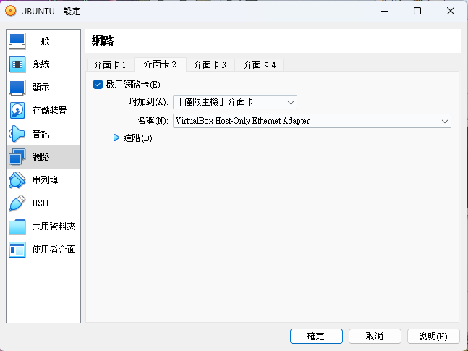
先設定網路介面卡

Slide 3
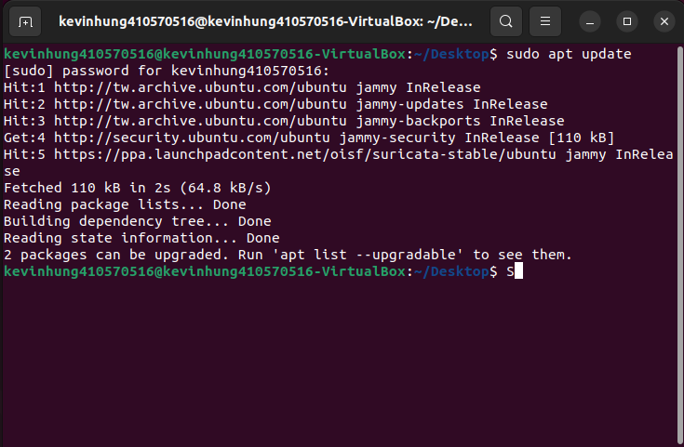
sudo apt update

Slide 4
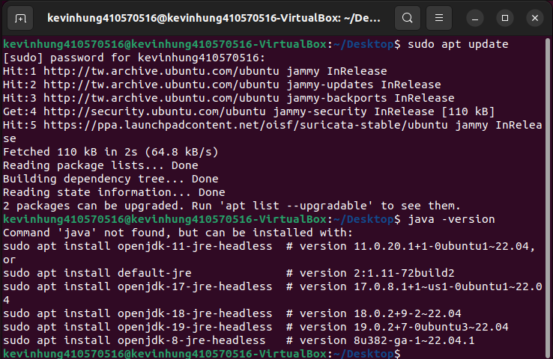
java -version

Slide 5
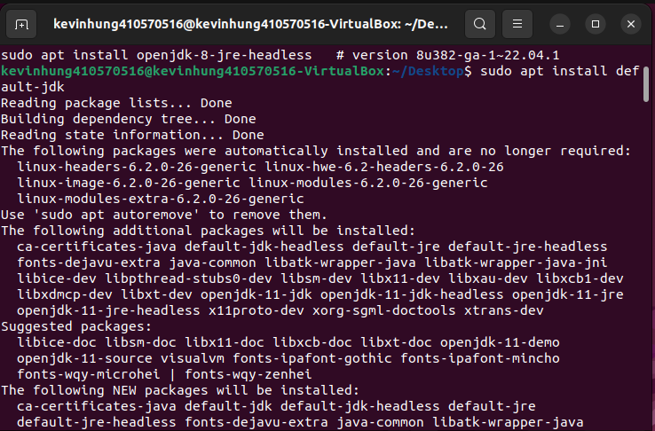
sudo apt install default-jdk

Slide 6
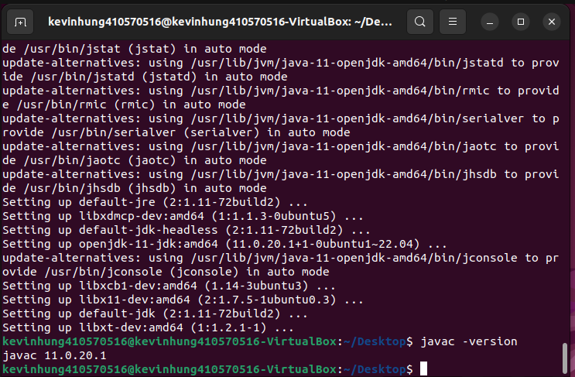
javac -version

Slide 7
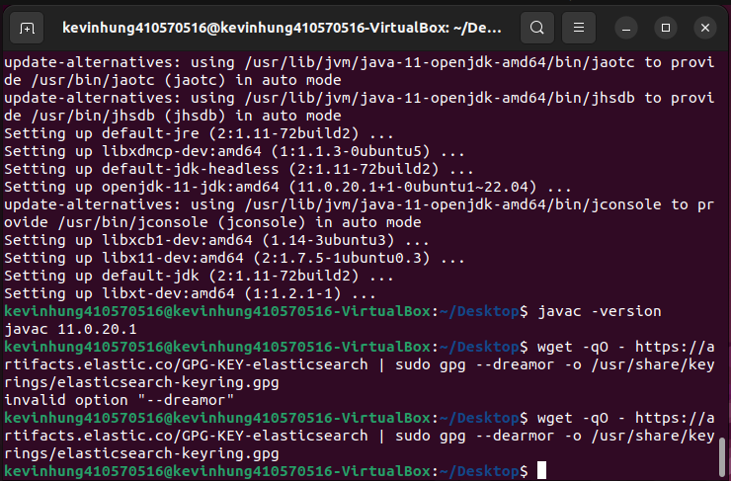
wget -qO - https://aritufacts.elastic.co/GPG-KEY-elasticsearch | sudo gpg –dearmor -o /usr/share/keyrings/elasticsearch.gpg

Slide 8
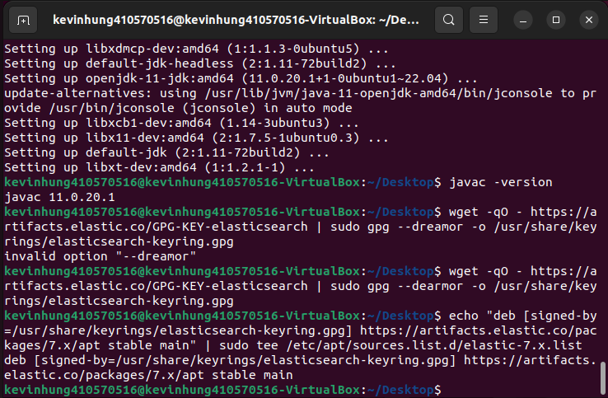
echo “deb [signed-by=/usr/share/keyrings/elasticsearch-keyring.gpg] https:artifacts.elastic.co/packages/7.x/apt stable main” | sudo tee /etc/aptsources.list

Slide 9
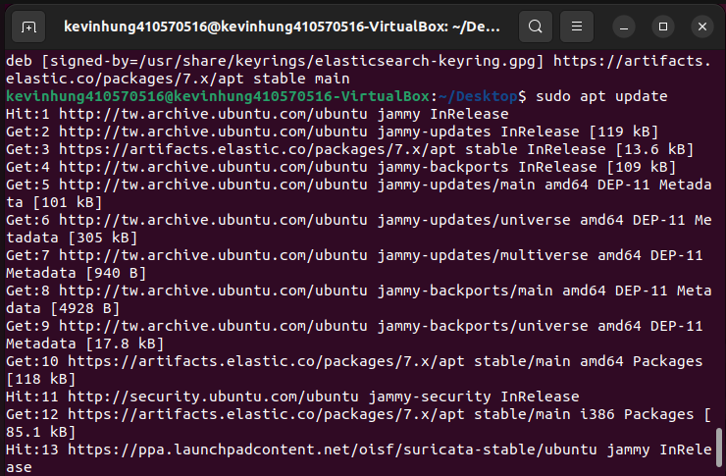
sudo apt update

Slide 10
sudo apt install elasticsearch kibana
這一張沒截到!

Slide 11
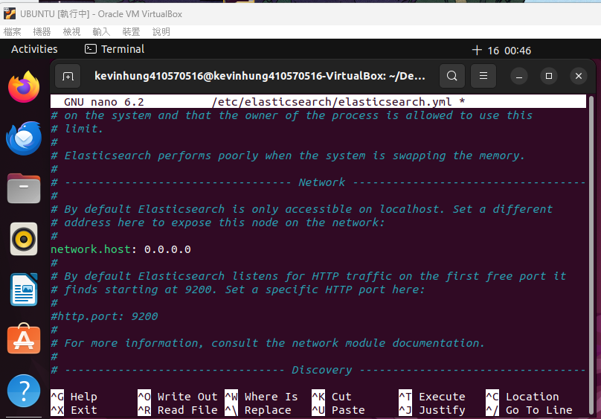
sudo nano /etc/elasticsearch/elasticsearch.yml
找network.host將註 解取消
192.168.0.1改為0.0.0.0

Slide 12
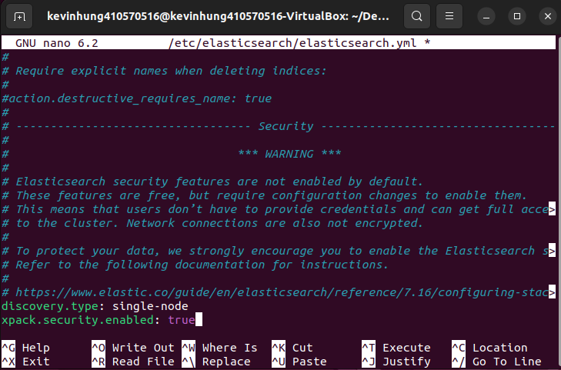
檔案尾加入
discovery.type: single- node
xpack.security.enabled: true

Slide 13
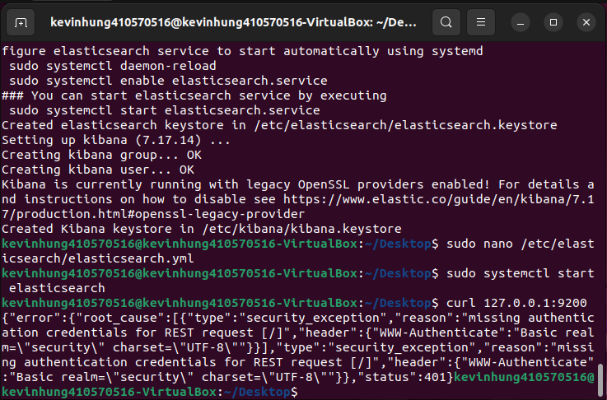
sudo systemctl start elasticsearch
$ curl 127.0.0.1:9200
error正常 是在測試

Slide 14
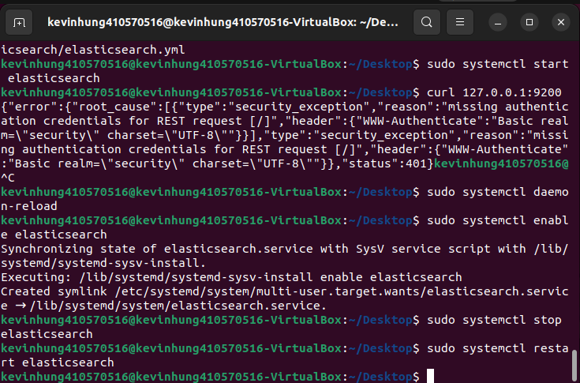
sudo systemctl daemon-reload
sudo systemctl enable elasticsearch
sudo systemctl stop elasticsearch
sudo systemctl restart elasticsearch

Slide 15
cd /usr/share/elasticsearch/bin
sudo ./elasticsearch-setup-passwords auto
Kibana elastic密碼記下來
沒截到QQ不過會有五個密碼，就先全部記下來

Slide 16
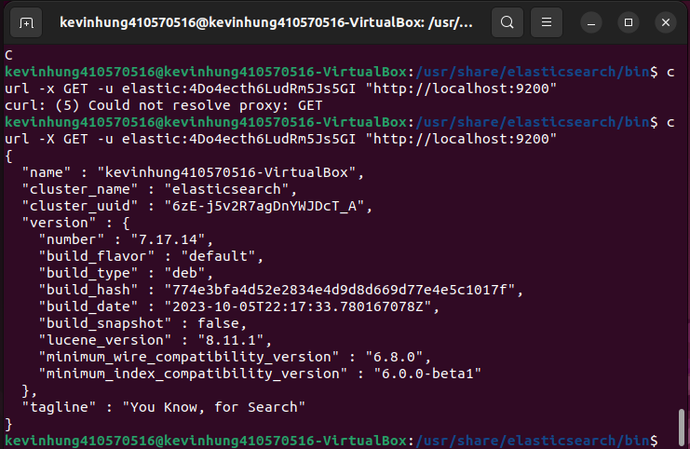
curl -x GET -u elastic:(上一部記下來的密碼) “http://localhost:9200"

Slide 17
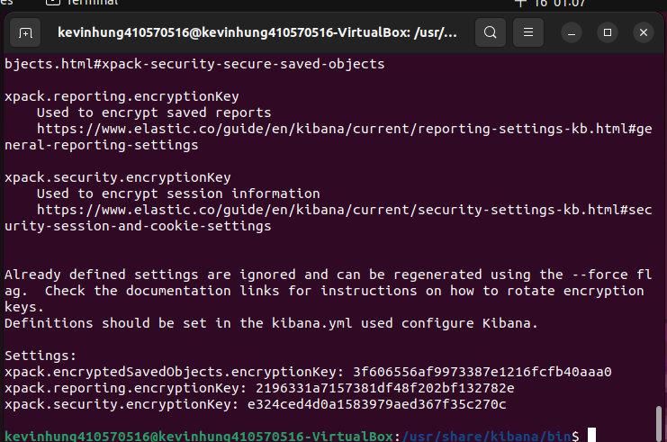
cd /usr/share/kibana/bin/
sudo ./kibana- encryption-keys generate
xpack三行複製

Slide 18
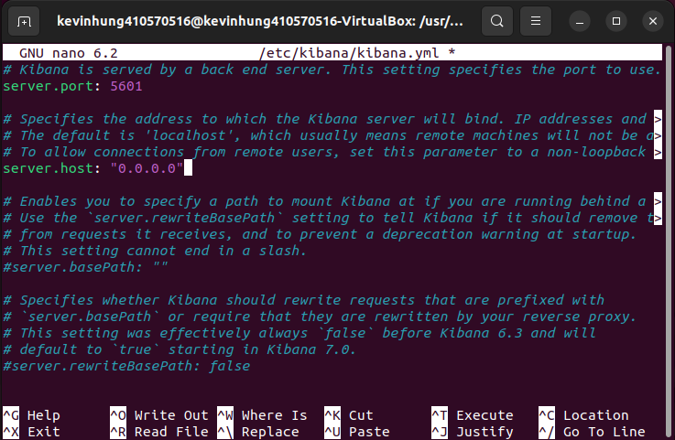
sudo nano /etc/kibana/kibana.yml
找 server.port: 5601 註解拿掉
找 server.host: "localhost" 註解拿掉， 將localhost改為0.0.0.0

Slide 19
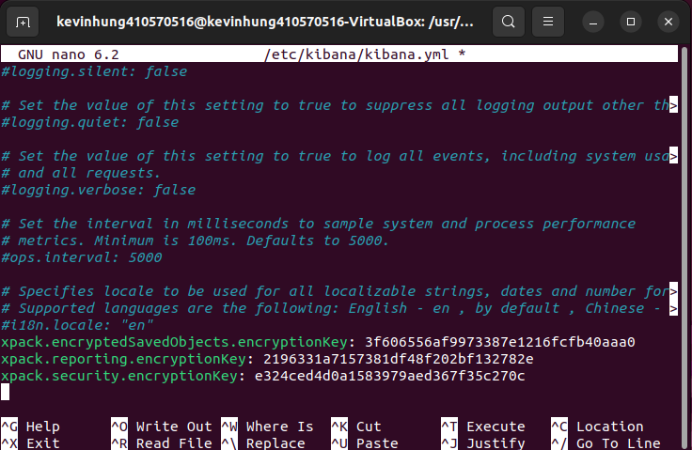
將xpack加到最後一行

Slide 20
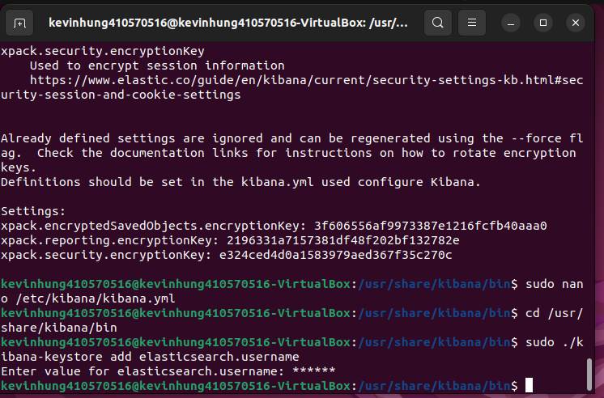
cd /usr/share/kibana/bin
sudo ./kibana-keystore add elasticsearch.username
username 填入kibana

Slide 21
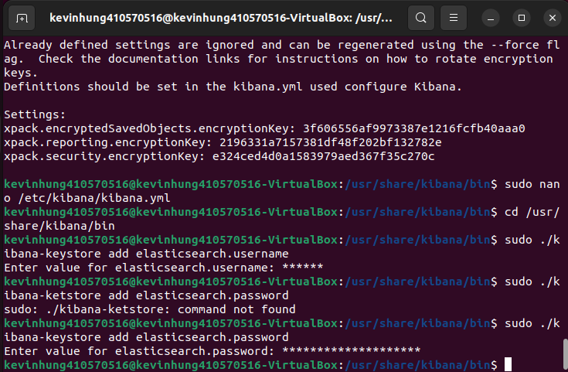
sudo ./kibana-keystore add elasticsearch.password
password前面叫你複製的kibana密碼

Slide 22
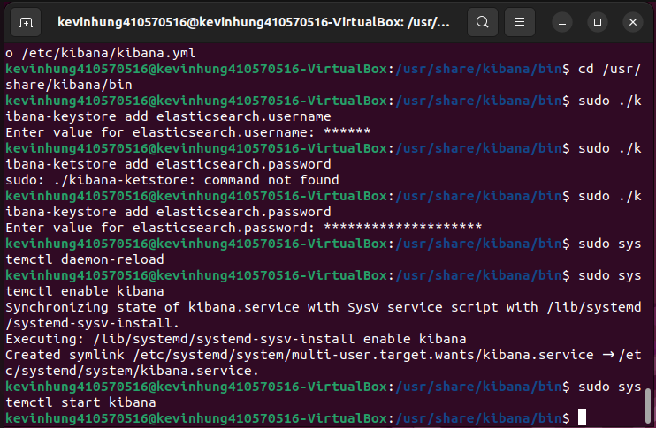
sudo systemctl daemon-reload
sudo systemctl enable kibana
sudo systemctl start kibana

Slide 23
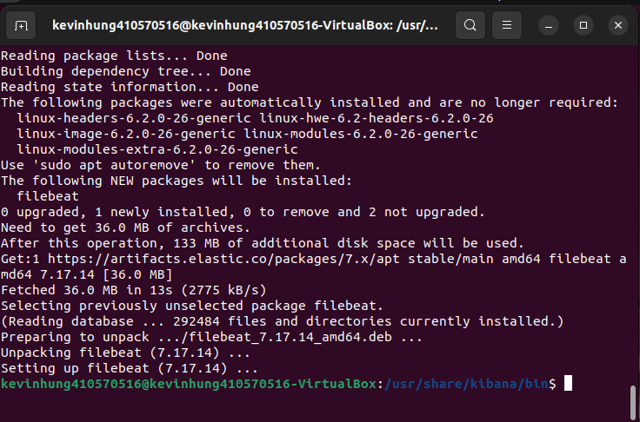
sudo apt install filebeat

Slide 24
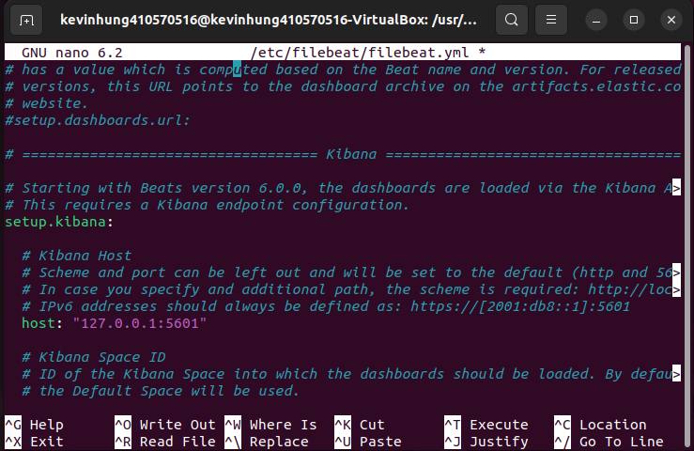
sudo nano /etc/filebeat/filebeat.yml
找setup.kibana: 下 #host: "localhost:5601"
拿掉註解將 localhost:5601改為 127.0.0.1:5601

Slide 25
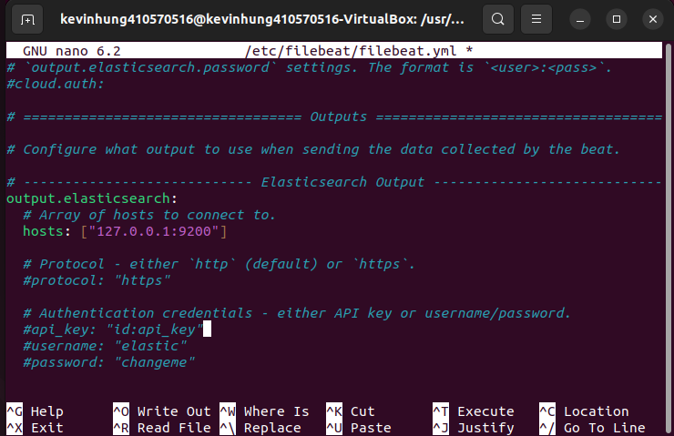
找到 output.elasticsearch: 下 hosts: 改成 127.0.0.1:9200

Slide 26
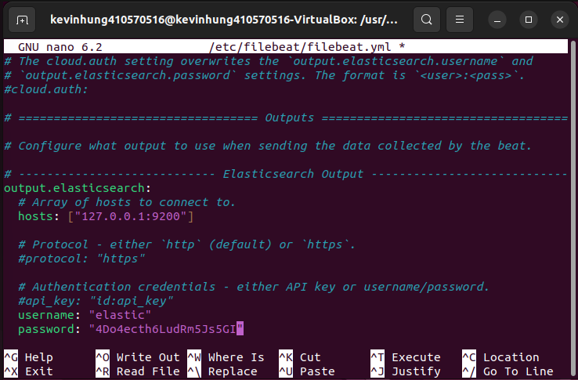
找 username帳號 改為 elastic
找 password密碼 改為前面記下的elastic的帳密

Slide 27
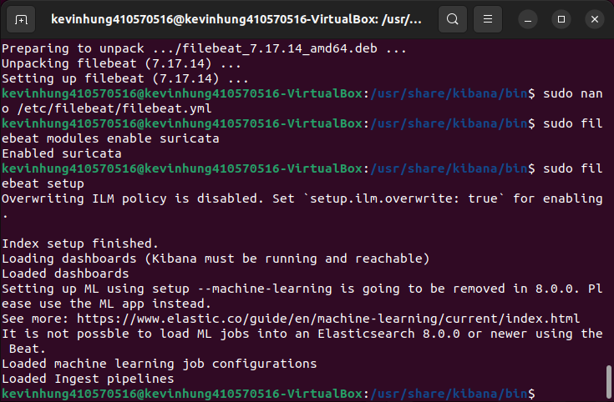
sudo filebeat modules enable suricata
sudo filebeat setup

Slide 28
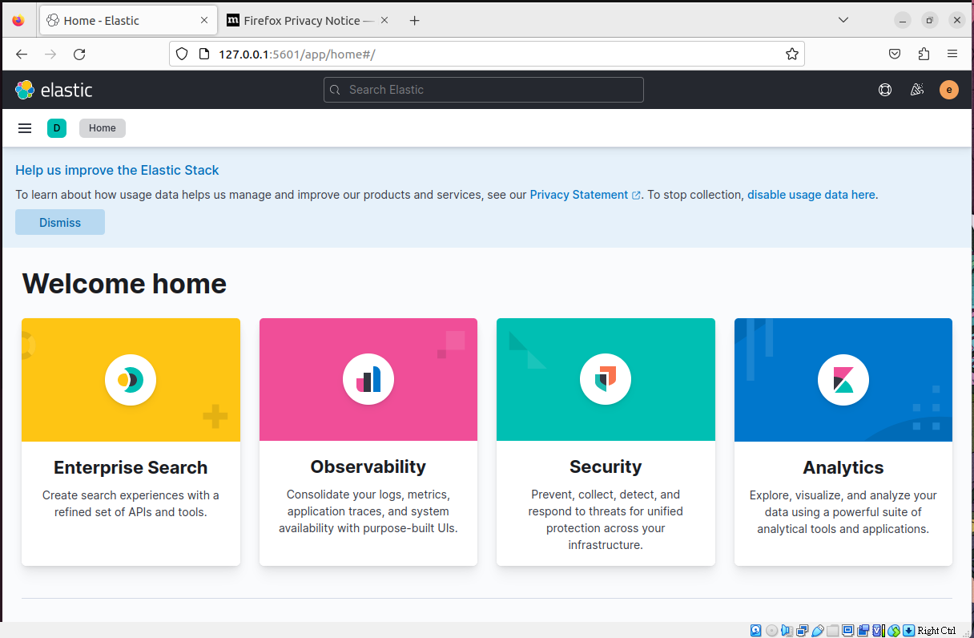
在瀏覽器輸入http://127.0.0.1:5601/
帳號密碼打前面叫你記的elastic的帳密

Slide 29
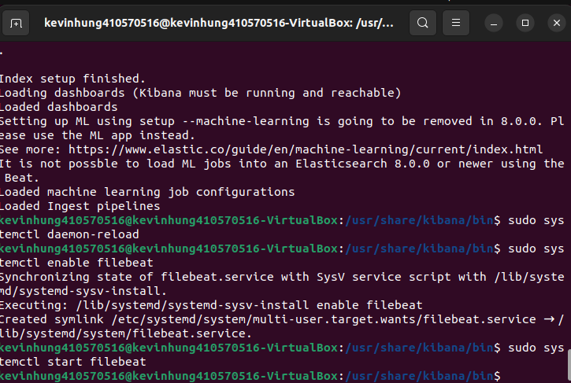
sudo systemctl daemon-reload
sudo systemctl enable filebeat
sudo systemctl start filebeat

Slide 30
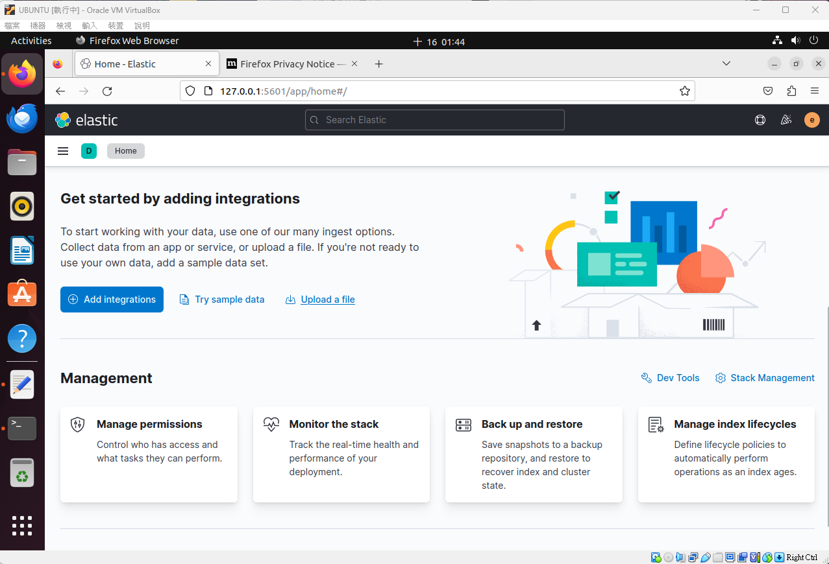
在kibana page 點upload file

Slide 31
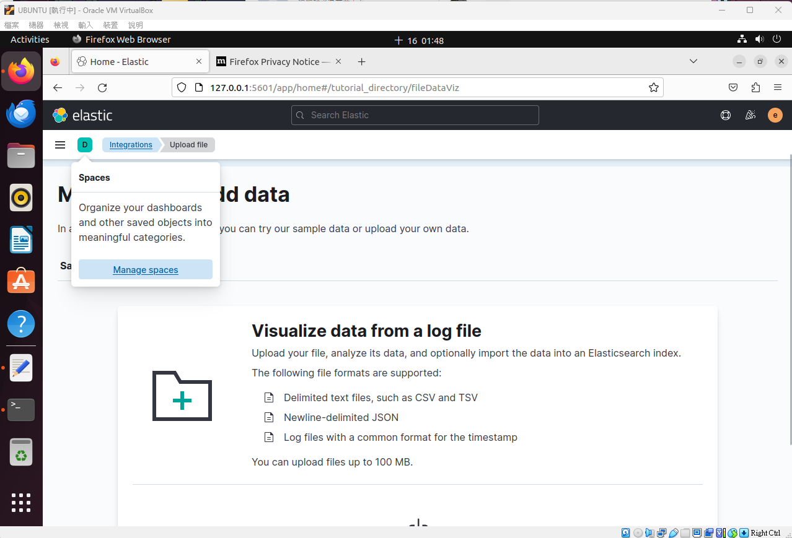
manage space

Slide 32
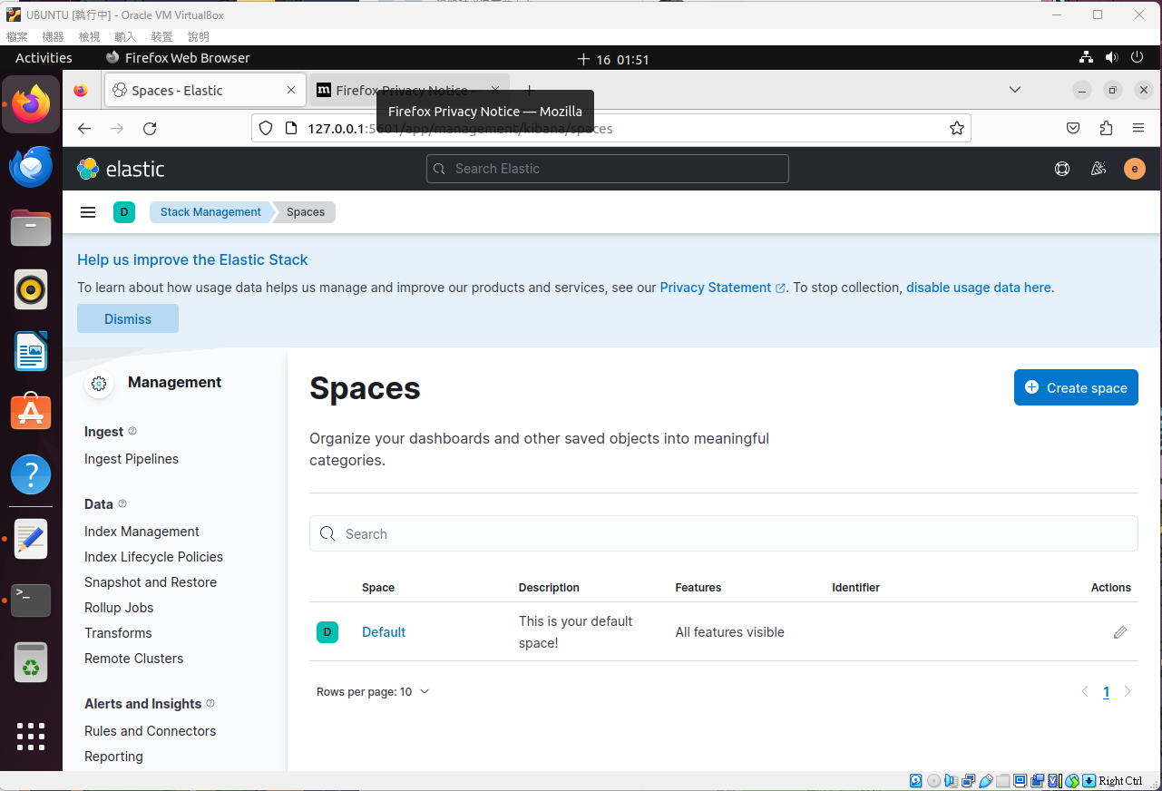

Slide 33
選單下滑index patterns，點create index pattern
打filebeat-7.17.11-2023.07.05-000001跟右邊的一樣
沒截到 qqqqqqqq

Slide 34
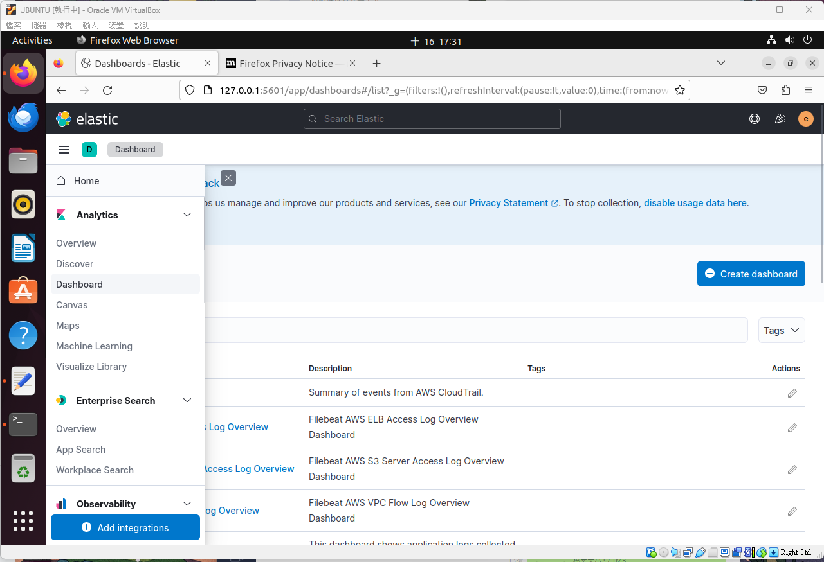
建成功後點左上選dashboard後create

Slide 35
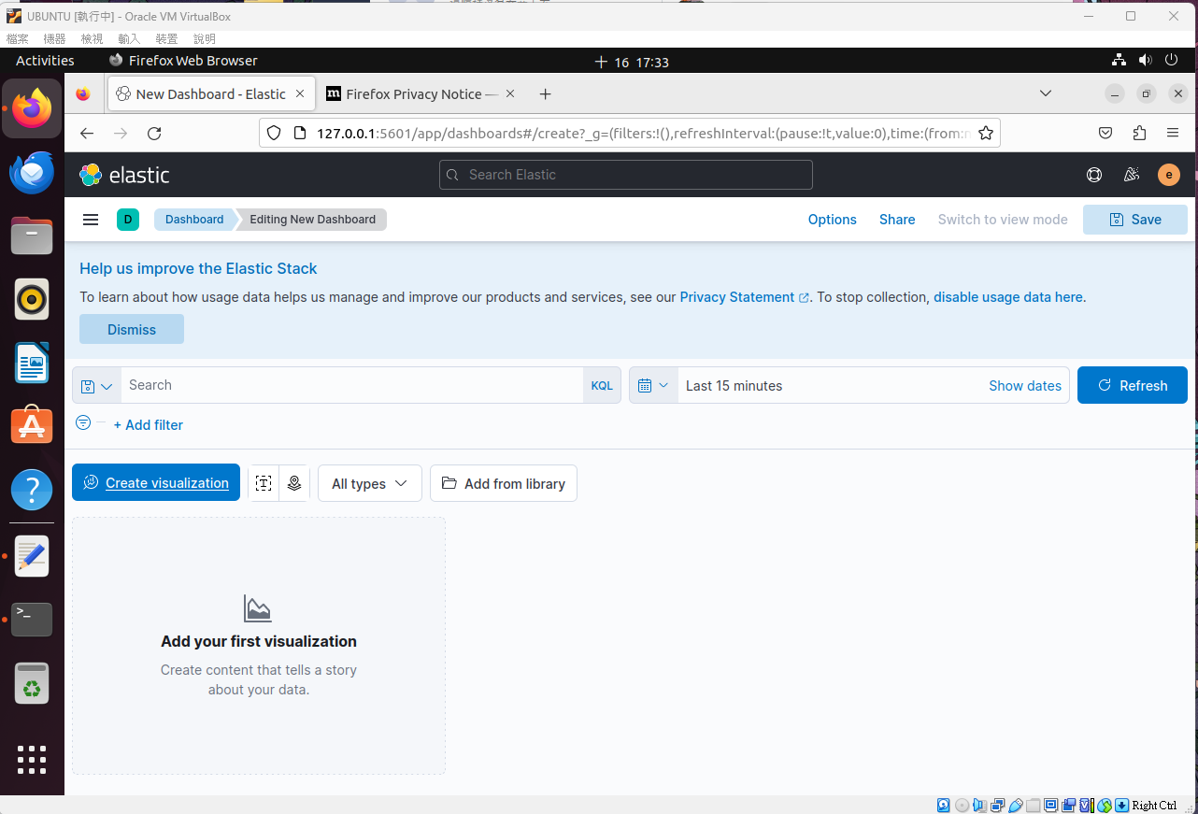
create visualization

Slide 36
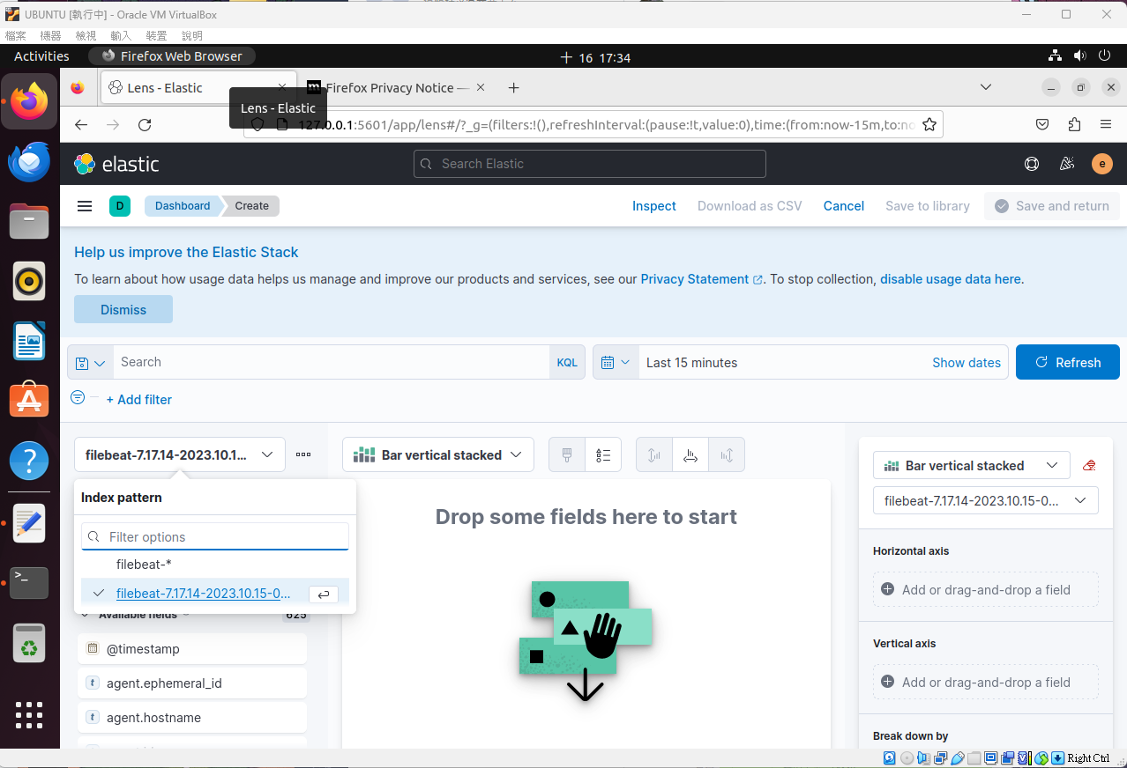
選擇filebeat-7.17.11-2023.07.05-000001

Slide 37
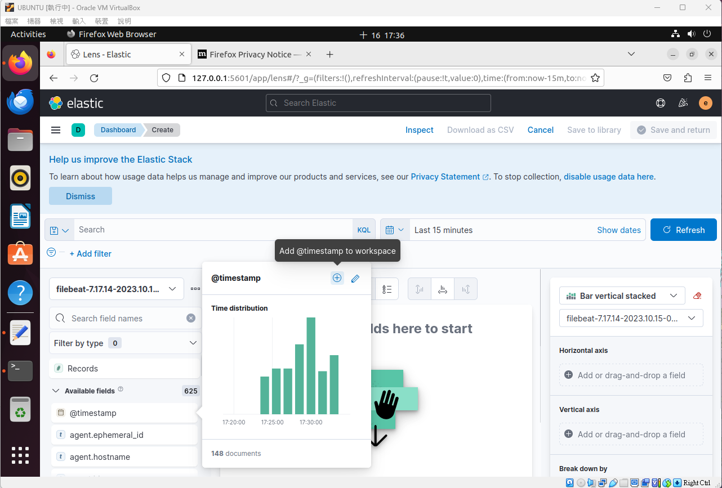
點@timestamp 然後按+

Slide 38
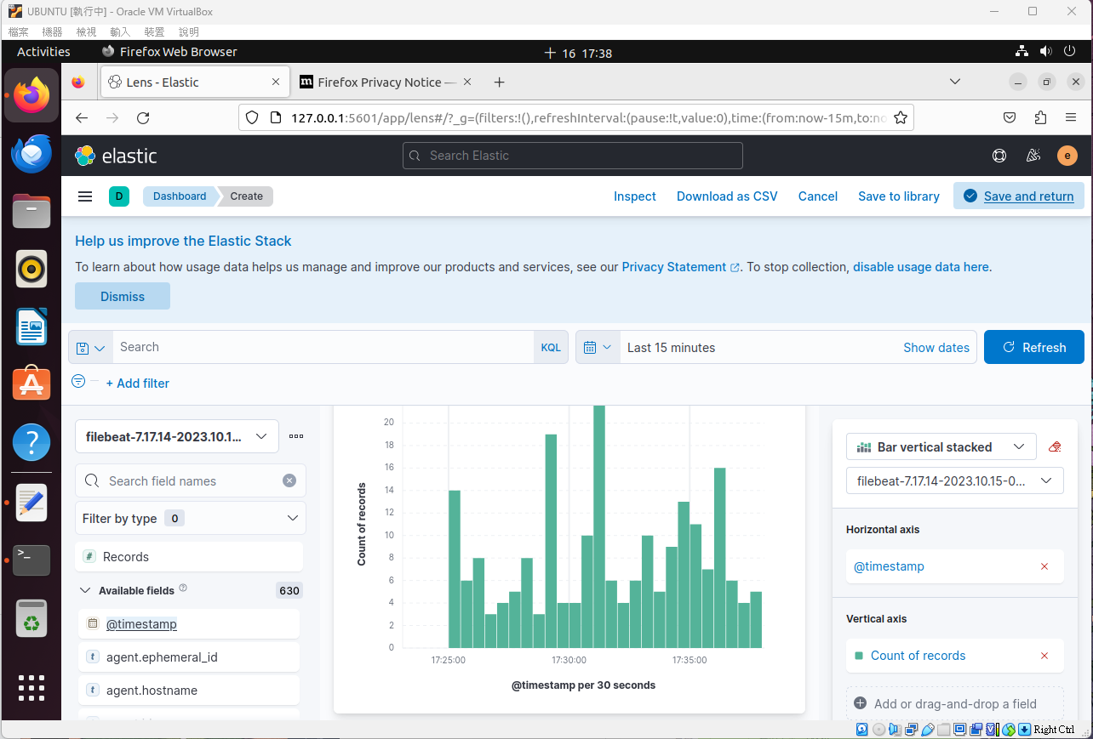
點save and return

Slide 39
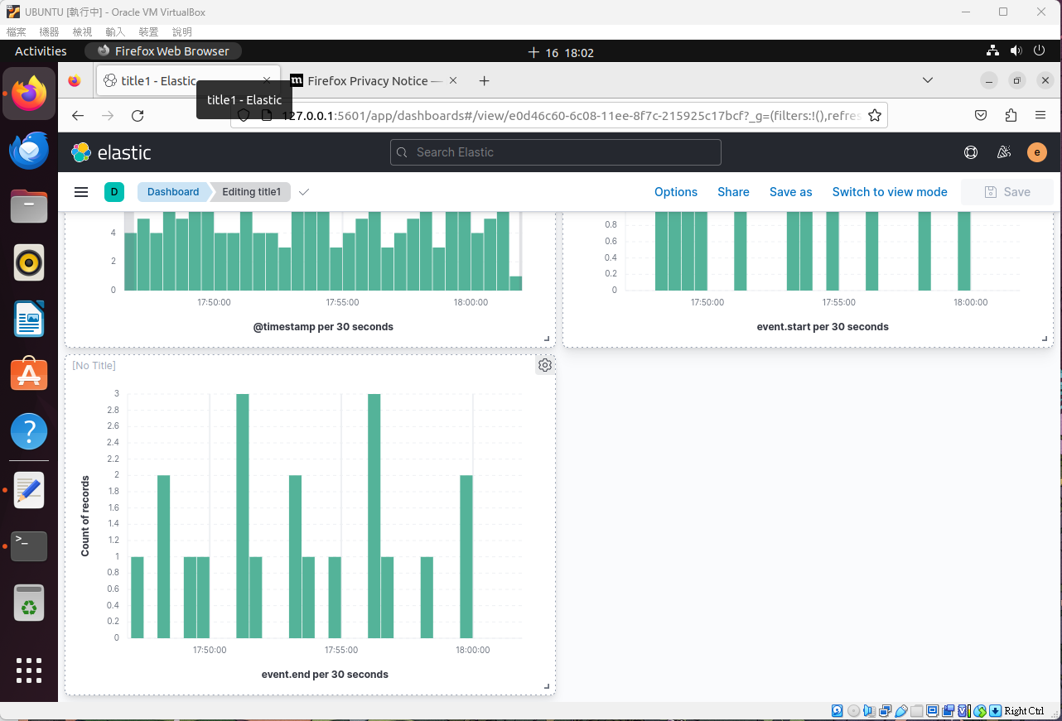
clone and edit搞出三個圖表

Slide 40
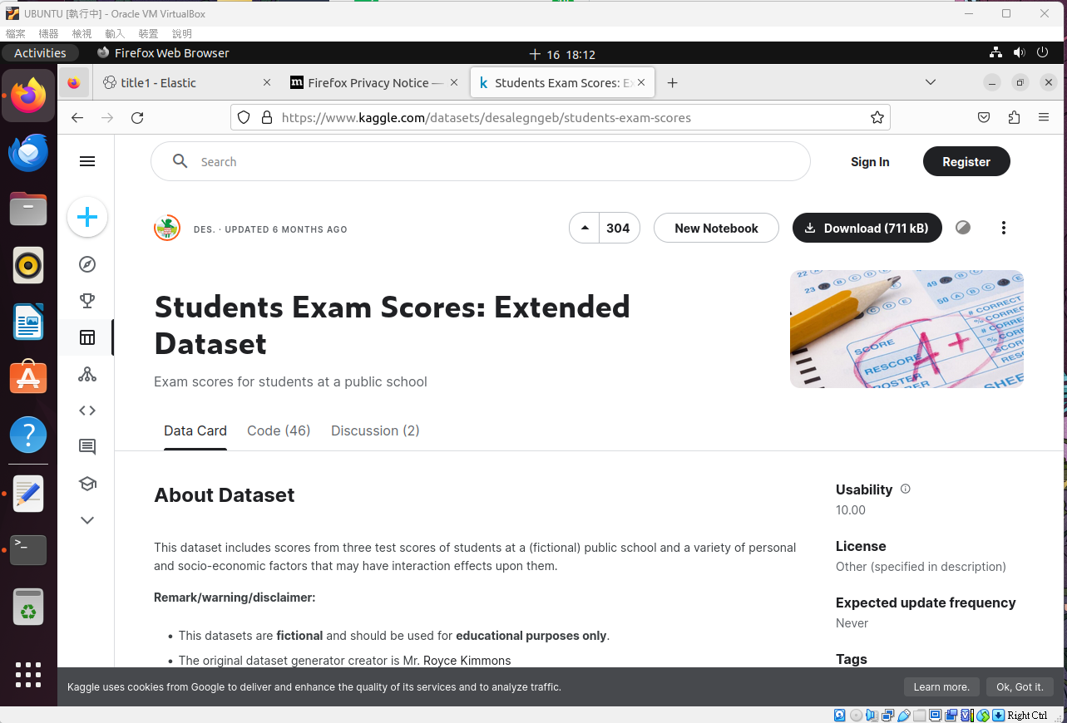
在fire fox 輸入https://www.kaggle.com/datasets/desalegngeb/students-exam-scores
然後download

Slide 41
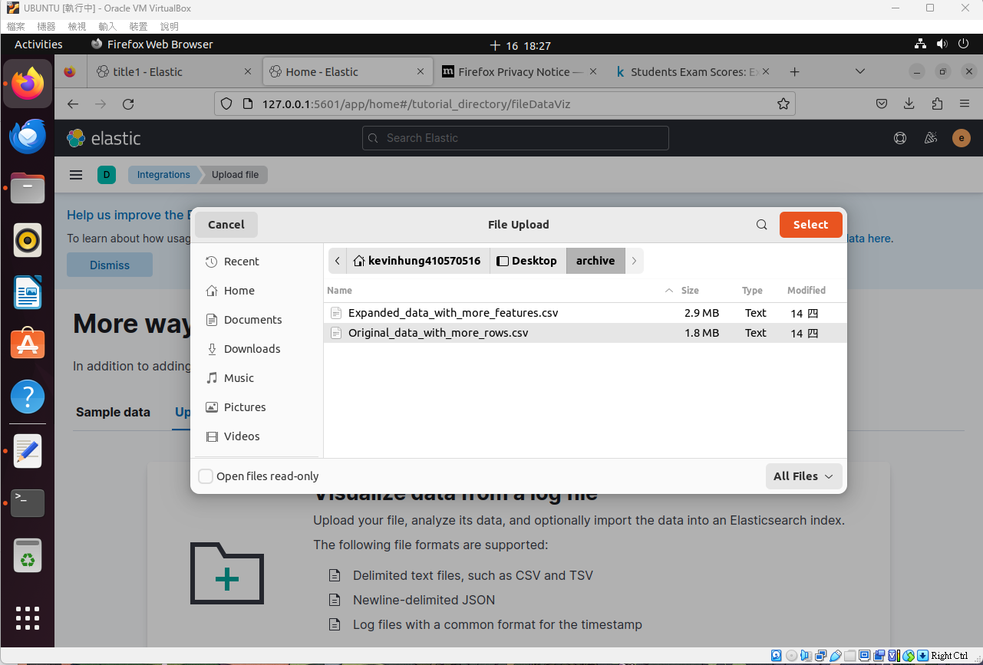
載完會有這兩個檔案，然後將original的那個upload

Slide 42
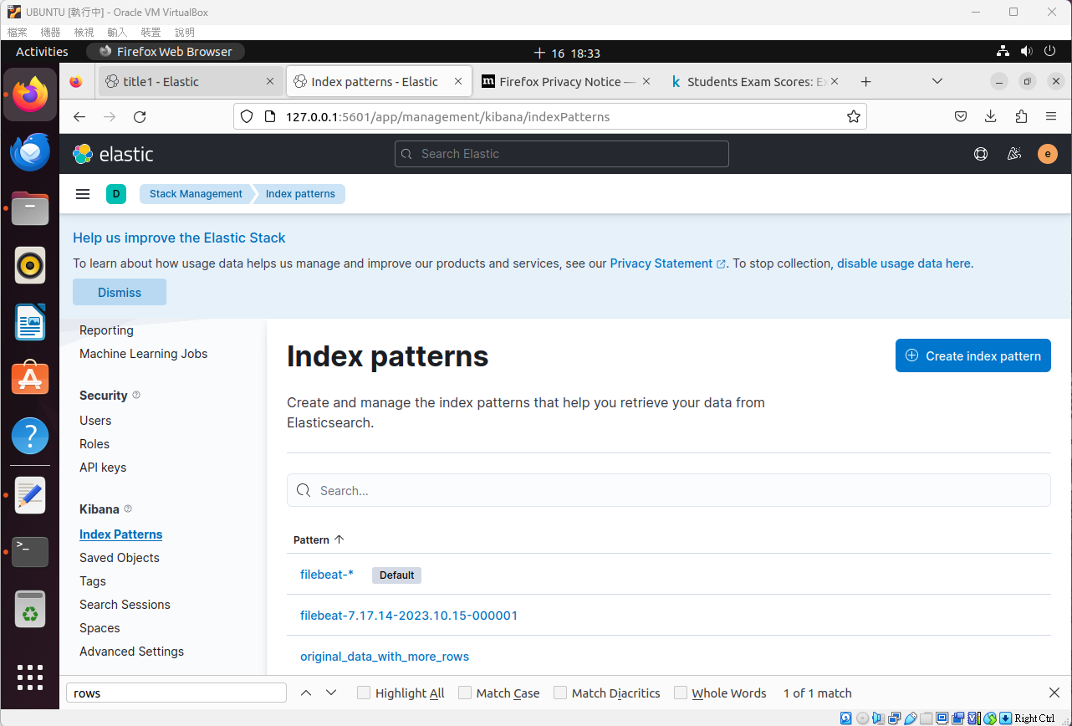
完成後去manage space找index patterns 然後create patterns 然後在建立dashboard

Slide 43
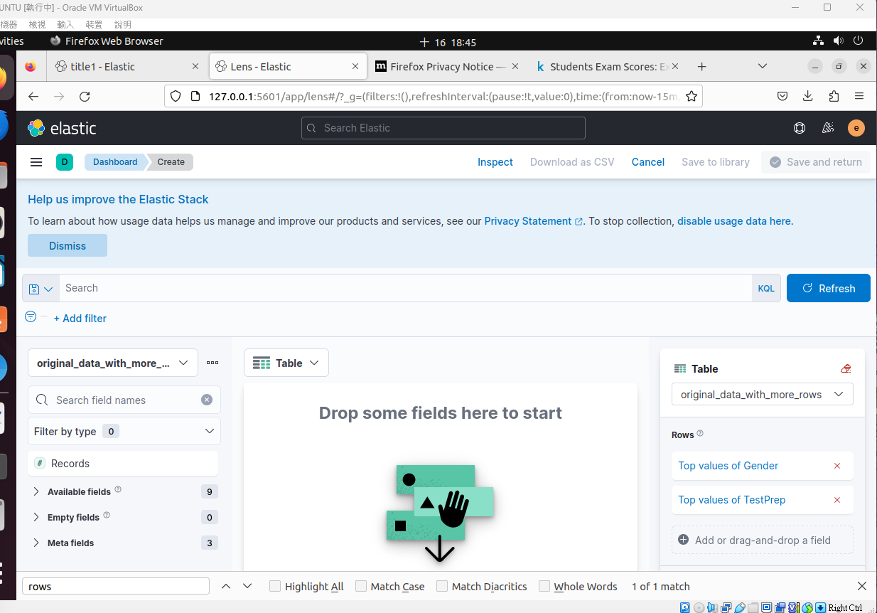
在rows選 top value of gender and top values of TesrPrep
然後格式選table

Slide 44
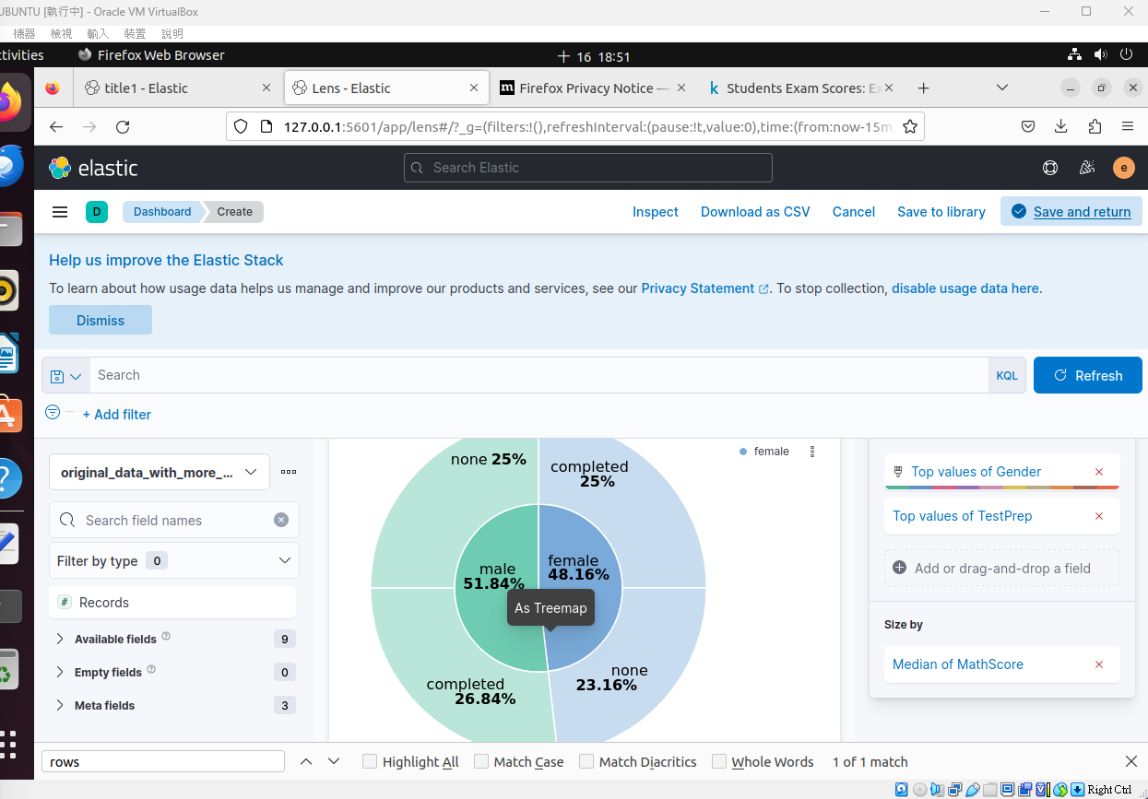
最後size by那邊選median of mathscore
然後save and return

Slide 45
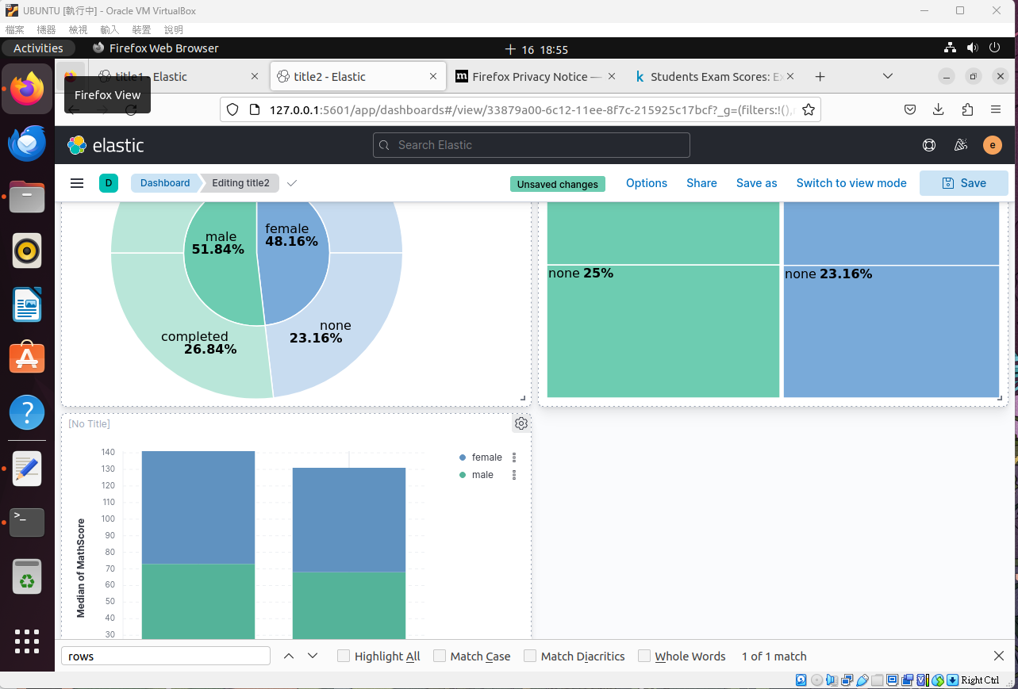
最後一樣clone and edit 弄出三個不一樣的圖表就好啦

Slide 46
作業到這邊 謝謝!

